Slide 1
Body idioms

Slide 2
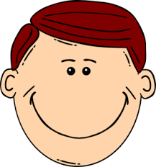
HEAD

Slide 3
TO BANG YOUR HEAD AGAINST A BRICK WALL
to keep trying to do sth. that will never be successful
TO BURY YOUR HEAD IN THE SAND
refuse to admit that a problem exists or refuse to deal with it
TO BITE/SNAP SB’S HEAD OFF
to shout at somebody in an angry way
CAN’T MAKE HEAD NOR TAIL OF STH.
to be unable to understand sth.

Slide 4
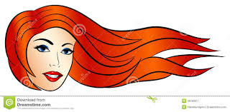
HAIR

Slide 5
TO KEEP YOUR HAIR ON
to calm down, to stay cool
TO MAKE SB’S HAIR STAND ON END
to shock or frighten sb.
TO TURN A HAIR
to show emotion
TO LET YOUR HAIR DOWN
to relax and enjoy yourself

Slide 6
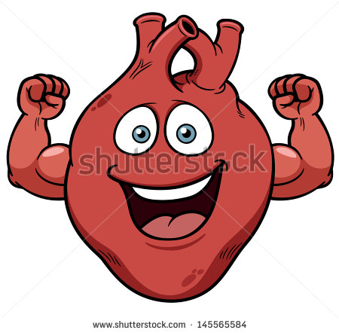
HEART

Slide 7
TO HAVE YOUR HEART IN YOUR MOUTH
to feel nervous about sth.
TO TAKE STH. TO HEART
to be very upset by sth. that sb. says or does
NOT HAVE THE HEART
to be unable to do sth. because you know that it will
make sb. sad or upset
YOUR HEART IS NOT IN STH.
not very interested or enthusiastic about sth.

Slide 8
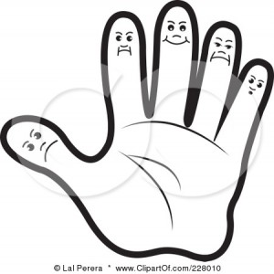
HAND

Slide 9
MANY HANDS MAKE LIGHT WORK
a job is made easier if a lot of people help
TO HAVE YOUR HANDS FULL
to be very busy or too busy to so sth. else
TO TAKE STH. IN YOUR HANDS
to deal with a particular situation yourself because you aren’t happy with how others are dealing with it
TO HAVE YOUR HANDS TIED
to be unable to do what you want because of rules, promises, laws

Slide 10
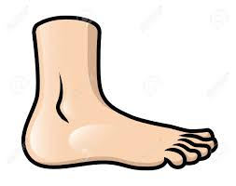
FOOT

Slide 11
TO SET FOOT IN/ON STH.
to enter or visit a place
TO PUT YOUR FOOT IN YOUR MOUTH
to say or do sth. that upsets, offends or embarrasses sb.
.
TO STAND ON YOUR OWN FEET
to be independent and able to take care of yourself
TO HAVE ONE FOOT IN THE GRAVE
to be old or ill that you are not likely to live much
longer

Slide 12
