Slide 1
A tense story

Slide 2
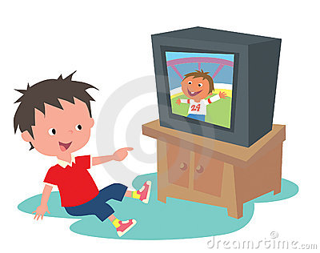

Slide 3
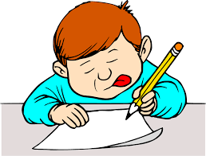

Slide 4
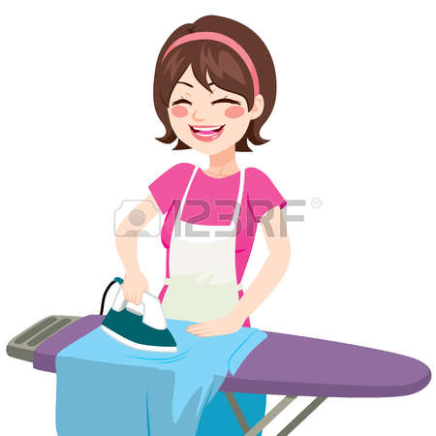

Slide 5
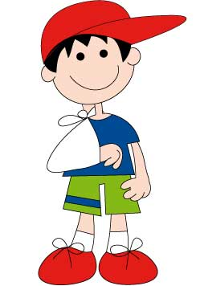

Slide 6


Slide 7
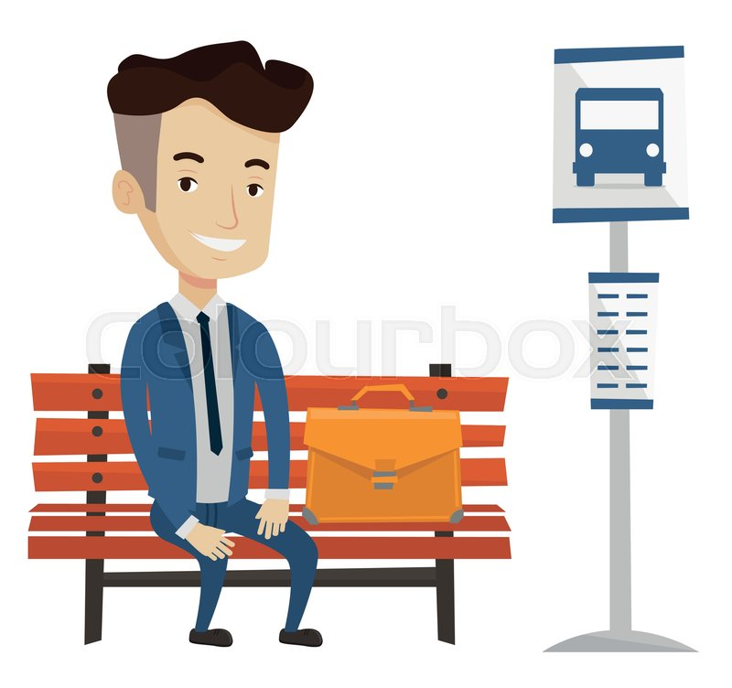

Slide 8
Yesterday evening my younger brother was watching a funny cartoon on TV whereas I had to do my homework.
Mum had already ironed dad's shirts before going to bed.
This is our neighbour Andy. Funny things often happen to him. Look at him! He has broken his arm, again! He slipped on the wet pavement yesterday morning. It was wet because it had been raining all night.
And I'm sure you're wondering where dad is. There he is at the bus stop. He has been waiting for the bus for half an hour already. He'll be late for work, again!

